Slide 1
APA Ch. 6
Mechanics of Style

Slide 2

Style?
Refers to guidelines for clear communication and presentation.
Goal of scientific writing is to communicate information!
No ambiguity! Your writing should have a clear message!

Slide 3
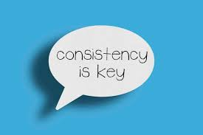
Style?
Other benefits:
  Consistency:
    “Health-care” vs. “Health Care” vs. Healthcare”
    Lack of consistency == distracting to the reader!
Consistent style makes your writing look polished and professional!

Slide 4
Elements of Style
Punctuation
Spelling
Capitalization
Font (italics and bold)
Abbreviations

Slide 5
Punctuation
Establishes the cadence (rhythm) of a sentence.
Where do readers pause, stop, or take a detour?
Spacing and punctuation:
  Insert one space at the end of a sentence or following a comma, semicolon, etc.

Slide 6
Spacing Exceptions
Abbreviations
  U.S. vs. U. S.
Ratios
  3:4 vs. 3 : 4
Otherwise, use ONE space! (don’t double space!)

Slide 7
Periods and Commas
End of the sentence.
Initials (e.g., Maxwell, N. P.)
Latin abbreviations (e.g., i.e., et. al, etc.)
  More on these later!

Slide 8

Periods and Commas
,
A comma is a punctuation mark that indicates a pause is needed in a sentence.
Commas help to clarify meaning for the reader.
Used to connect clauses
Notes:
Key Concepts: The facilitator may choose to invite the audience to respond to the title question and allow participants to discuss the function of the comma. Many writers become frustrated with comma usage because they are unsure of where to place them in their sentences. This presentation is designed to demystify the placement and usage of commas.
The facilitator may stress to participants that commas should not be ignored in writing; they are often needed to clarify meaning within a sentence and can help to avoid confusion.
Click mouse after title question to reveal each response.

Slide 9
Clauses
A clause is a group of words that contains both a subject and a verb that complement each other.
A phrase is a group of words that does not contain a subject or a verb that complement each other.
Clauses
Dependent
Independent
Notes:
Key Concepts: This slide articulates the basic differences between a clause and a phrase. The facilitator may stress the importance of understanding these definitions for understanding comma placement.

Slide 10
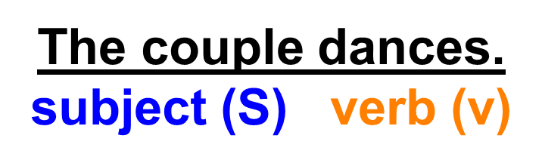
Independent Clauses
A complete sentence has at least two components, a subject and a verb.
The subject and verb must form a complete thought to be considered an independent clause.
Notes:
Key Concepts: This slide explains the structure of an independent clause, the primary building block for the development of any sentence. An independent clause requires a subject and a verb that can stand as a complete thought. Sentences can be very short, as the one detailed in the slide. The facilitator may ask the audience to identify the subject and verb in the example.

Slide 11

Compound Sentences
Compound Sentence: a sentence that contains two independent clauses joined by a coordinating conjunction
A conjunction joins words, phrases, and clauses together in a sentence.
Conjunctions (remember with the acronym FANBOYS):
Notes:
Key Concepts: This slide explains the structure of a compound sentence and the role of a conjunction. An easy method for remembering the seven coordinating conjunctions is the acronym “fan boys.”

Slide 12

Compound Sentences
The comma in a compound sentence is placed before the coordinating conjunction.
Notes:
Example: This slide exemplifies the location of a comma in a compound sentence, before the coordinating conjunction. The facilitator may ask participants to identify the subjects, verbs, and conjunction in the example.

Slide 13

Compound Sentences
Where would you place the comma in the following sentence?
Notes:
Example: This slide provides participants with an opportunity to locate the correct position for the comma within the sample sentence. The facilitator may also invite students to identify the subjects, verbs, and conjunction in the sentence.

Slide 14
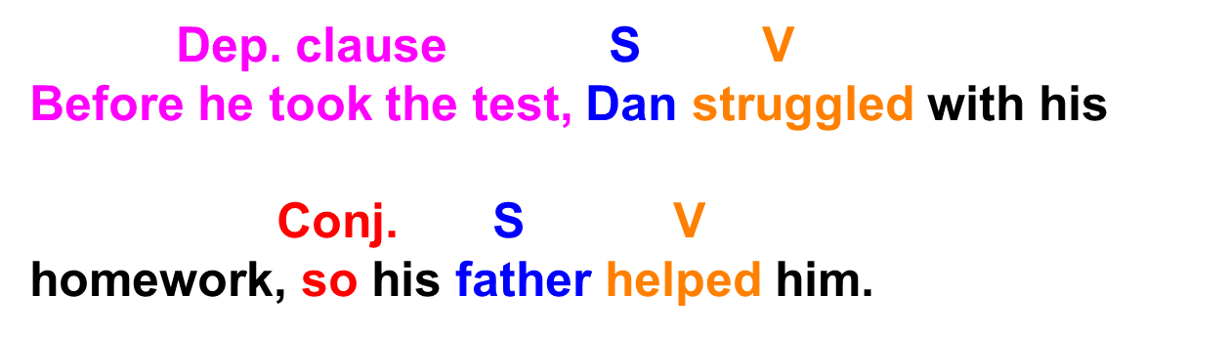
Introductory Clauses
When a dependent clause is placed at the beginning of a sentence, place a comma between the independent clause and the dependent clause.
Notes:
Key Concepts: An introductory clause is a dependent clause located at the beginning of a sentence. After an introductory clause, a comma is needed to distinguish it from the independent clause.
Activity: The facilitator may choose to ask students to identify the independent and dependent clauses, the subjects, the verbs, and the dependent clause marker in the sample sentence.

Slide 15


Introductory Clauses
Where would you place the comma in the following example?
Notes:
Activity: Click to reveal answer.

Slide 16

Dependent Clauses
When a dependent clause is located after an independent clause, do not place a comma between the two.
Notes:
Activity: When a dependent clause follows an independent clause, commas are not used. Facilitators may choose to ask students to identify the parts of speech in the example.

Slide 17

Essential Phrases and Clauses
An essential clause or phrase is used to modify a noun. It adds information that is critical to the meaning of the sentence.
Essential clauses are not set off by commas.
Notes:
Key Concepts: This slide leads off a section about essential and non-essential phrases and clauses. Essential phrases and clauses—elements that add critical information to the meaning of a sentence—do not have commas placed around them. For the slide example: Without the essential phrase, this sentence does not make complete sense : The people are loud! While the sentence is grammatically correct, we don’t know about the people being discussed.

Slide 18
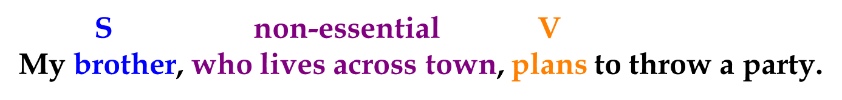
Essential Phrases and Clauses
A nonessential clause or phrase adds extra information to a sentence. This information can be eliminated from the sentence without influencing the meaning of the sentence.
Always place commas around nonessential phrases and clauses.
Best NOT include this information unless ABSOLUTELY necessary.
  Remember to strive for concision!
Notes:
Key Concepts: This slide illustrates the difference between essential and nonessential elements. While commas should not be placed around essential phrases and clauses, they should be placed around nonessential phrases and clauses.

Slide 19
Using Commas in Lists
Place commas in a sentence to divide items in a list.
The commas will help the reader to avoid confusion.
The comma before the conjunction is generally required, but it can be omitted if there is no possibility of confusion.
Notes:
Key Concept: Commas should be placed between each element within a list. This placement can help the reader to avoid confusion.

Slide 20

Oxford Comma
What about the final comma in a list?
  Referred to as “the Oxford Comma”
Example:
  “Blue, Red and Green”
  “Blue, Red, and Green
Include it! We want to be as precise as possible and avoid any possible confusion!
Notes:
Key Concept: Commas should be placed between each element within a list. This placement can help the reader to avoid confusion.

Slide 21
Commas and Lists
Consider the difference in the following:
Last month, Alex dated Mary Ann Lee and Kim.
Last month, Alex dated Mary, Ann, Lee, and Kim.
Last month, Alex dated Mary Ann, Lee, and Kim.
How many women did Alex date?
Notes:
Activity: These examples illustrate the importance of comma placement within a list. The facilitator may ask students to answer the question “How many women did Alex date?” in accordance with each example—two women in the first, four in the second, and three in the third.

Slide 22

Common Errors: The Comma Splice
A comma splice is an error in which two independent clauses are joined by a comma.
Notes:
Key Concepts: One of the most prevalent comma errors is the comma splice—the placement of a comma between two independent clauses.

Slide 23



How to fix it?
Insert a conjunction between the two independent clauses
Start a new sentence
Insert a semi-colon between the two independent clauses
Notes:
Key Concepts: This slide enumerates several methods for correcting comma splices. The examples listed in the next three slides are corrections of the comma splices in the previous slide.

Slide 24
Semicolons (;)
Use a semicolon between two complete sentences. Each sentence on either side of the semicolon must be complete with its own subject and verb. Keep in mind that a semicolon functions the same way as a period and a capital letter.
Not all poetry is serious and difficult to read and interpret. The poetry of Maya Angelou, for instance, is rhythmic, folksy, and easy to read.
In these two sentences, the content is closely related, so we can tie them together by substituting a semicolon for the period and the capital letter.
Not all poetry is serious and difficult to read and interpret; the poetry of Maya Angelou, for instance, is rhythmic, folksy, and easy to read.

Slide 25
Semicolons Joining Sentences
Use a semicolon between two complete sentences connected by words such as however, therefore, consequently, nevertheless, and then.
  Dr. Jones created an information sheet to help her patients use their medication properly; however, her patients’ blood tests did not reflect improvement.
“Dr. Jones created an information sheet to help her patients use their medication properly” is a complete sentence.
“However, her patients’ blood tests did not reflect improvement” is also a complete sentence. The introductory element “however” doesn’t change anything; we can still use a semicolon to tie the two sentences together.

Slide 26
Semicolon No-No’s
Do not use a semicolon between an independent clause and a phrase or a dependent clause.
Example:
  You should not make such inflammatory statements; although they are correct.
Why???
  “Although they are correct” is not a complete sentence.

Slide 27
Semicolon No-No’s
Do not use a semicolon interchangeably with a comma.
Example:
  I enjoy sports; particularly tennis, soccer, and fishing.
Why???
  “Particularly tennis, soccer, and fishing” is not a complete sentence.

Slide 28
Semicolon No-No’s
Do not use a semicolon to substitute for a colon.
Example:
  The military expects one thing from its rank and file; obedience.
Why???
  “Obedience” is not a complete sentence.

Slide 29
Colons (:) with Items in a List
Use a colon between a complete sentence and a list or explanation. Note that a complete sentence must precede the colon.
  There is one common disease on this campus: Computer viruses.
  The players came from all over the world: Germany, Russia, Japan, Canada, and Australia.
Lists can contain only one item (usually more though)
Caps first word after colon!

Slide 30
Colons with “The Following”
Use a colon after “the following” and “as follows”:
Example:
  The workshop will include the following topics: anger management, stress management, communication skills, and sexual harassment awareness.
The portion of this sentence that comes before the colon is a complete sentence.
The portion that comes after the colon is a parallel list.

Slide 31
Use of Italics
Italicize key terms or phrases, especially when providing a definition
Example:
  Mindfulness is defined as….
Titles of academic journals
  Remember the reference page formatting?

Slide 32
Numbers
Expressed as a numeral (10)
Expressed as a word (ten)
When to use which?
  Numbers below 10 – write out as word (e.g., eight)
  Numbers 10 or higher – write as a numeral (291)
    Exception: Use the word form for all numbers that start a sentence!

Slide 33
Common Stats Symbols
N == number of subjects
M == mean
Sd == standard deviation
df == degrees of freedom
p == p-value (significance?)

